Slide 1


Notes:
Click the Begin your presentation

Slide 2

Identifying Russian Troll Accounts on Twitter
IST 718 Big Data Analytics Final Project, Spring 2019
Adil Gokturk
Drew Howell
Scott Snow
Notes:
• Hi Guys
• I am Adil, [Scott, Drew]
• For our project we decided to analysis Russian Troll Tweets.

Slide 3



Story & Hypothesis
According to the House Intelligence Committee investigation, Russia’s Internet Research Agency attempted to interfere with the 2016 U.S. election by running fake accounts on Twitter, known as “Russian trolls”.
Our hypothesis Questions
Would it be possible to demonstrate whether these tweets used to manipulate/target the 2016 U.S. election to favor on any presidential candidate?
Would it be possible by developing machine learning models to predict whether a Twitter account is a Russian troll/fake?
Notes:
In October 2018, Twitter in keeping with its recent promise to Congress to be transparent about its attempts to prevent election interference on its platforms, released more than 10 million tweets that had been circulated by propaganda farms and their associated puppet accounts.
The goals of these propaganda farms, which mainly hail from Russia, involve not only the disruption of US politics but also the distortion of political debate in their own backyards.
According to the House Intelligence Committee investigation, Russia’s Internet Research Agency attempted to interfere with the 2016 U.S. election by running fake accounts on Twitter, known as “Russian trolls”.
Our main goal on this project is to find a data scientific way to demonstrate whether these tweets used to manipulate the 2016 U.S. election to favor on any presidential candidate?
In addition to that, we developed machine learning models to predict whether a Twitter account is a Russian troll/fake?

Slide 4
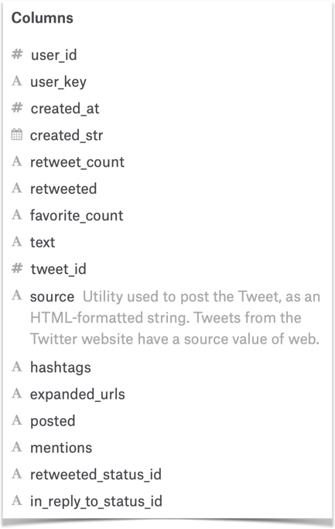
Data
Russian Troll Tweets
Source:
NBC News
https://www.nbcnews.com/tech/social-media/now-available-more-200-000-deleted-russian-troll-tweets-n844731
Kaggle - Russian Troll Tweets
https://www.kaggle.com/vikasg/russian-troll-tweets
Dimension:
203,482 tweets
16 variable columns
Data Sets:
tweets.csv
users.csv
Notes:
As I mentioned before, There are more than 10 million tweets related to Russian Troll Accounts!
We used mostly over two hundred thousand of them for our research.
We obtained the data sets from the Kaggale’s Russian Troll Tweets blog.
There are two data sets:
Tweets and Users

Slide 5
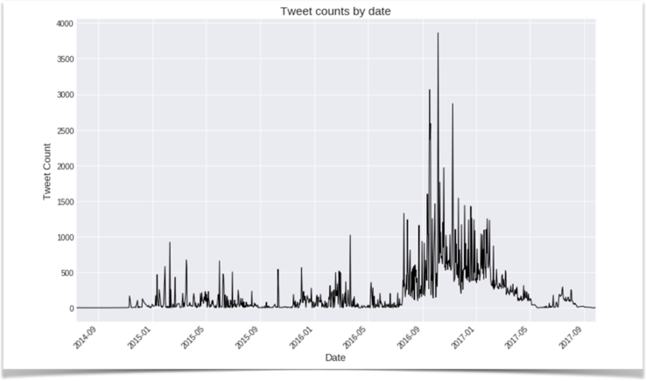
Exploratory Analysis
Time line of the tweets
3 years of tweets starts on July 14th, 2014 and ends on of September 26th, 2017
Notes:
Our Explanatory analysis most likely to find a way to demonstrate whether these tweets used to manipulate the 2016 U.S. election to favor on any presidential candidate
We first looked at the time line of the tweets:
3 years of tweets starts on July 14th, 2014 and ends on of September 26th, 2017

Slide 6
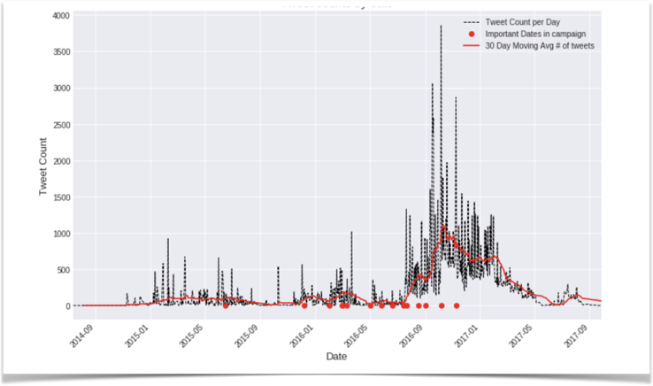

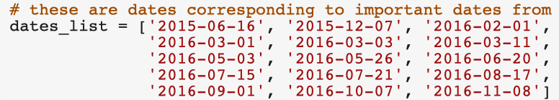
Time Line Comparison
Time line of the tweets comparison to the Trump’s campaign important event days
Relatively similar tweet trend activity between the Campaign and the troll accounts.
Notes:
Then compared to the President Trump’s Presidential Campaign’s important events days.
We discovered that the Relatively similar tweet trend activity between the Campaign and the troll accounts.

Slide 7
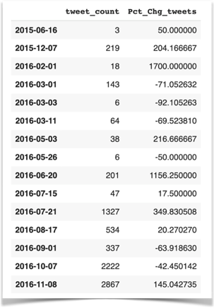

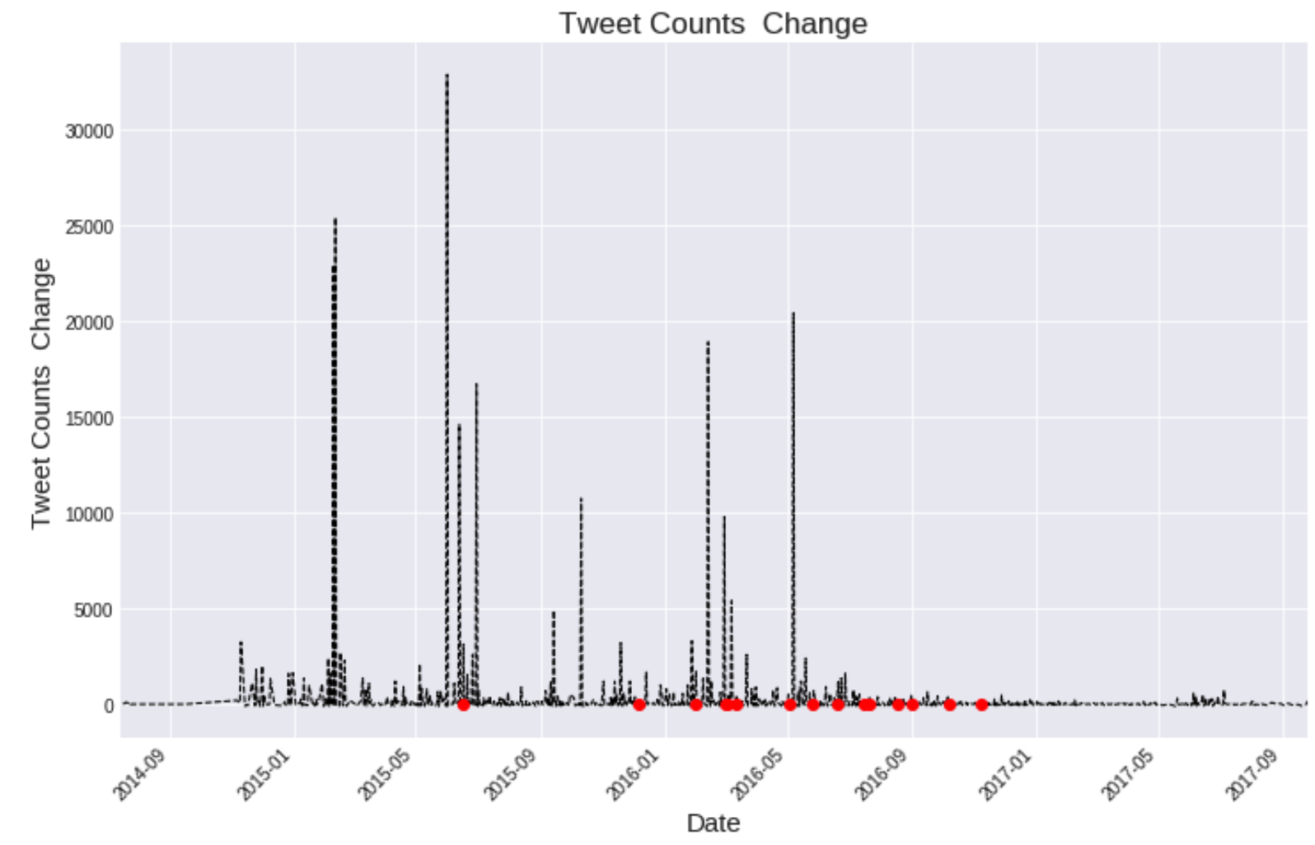
Percentage Change in Tweet Counts
Time line of the tweets comparison to the Trump’s campaign important event days
The US president was elected on November 8th, 2016 - the last red dot on the chart.
The tweet activity near the end of the campaign was increased.
Notes:
We also calculated the percentage change in tweet counts between subsequent dates and then see if an important date relates with a spike.
these dates are not in order
The table shows that for most of these dates, there was an increase in the tweet counts - some days as large as 350%.

Slide 8
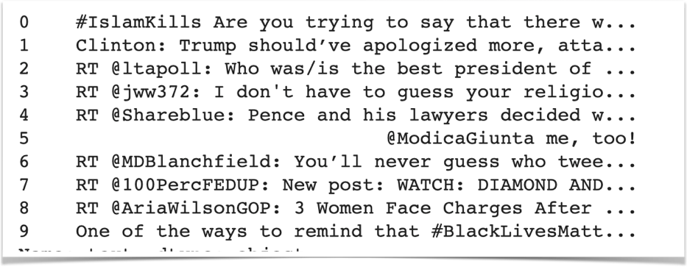
Text Analytics
Sample troll tweets
Need to scrub some column features from the data, such as RT mentions, links, hashtags, extra spaces
Notes:
These are sample troll tweets as you see on the screen..
We did some Scrubbing here;
the tweets contain extra elements like RT mentions, links and hashtags
We separated out these elements to analyze for different purposes, especially for the text mining
Drew will talk about more on that

Slide 9
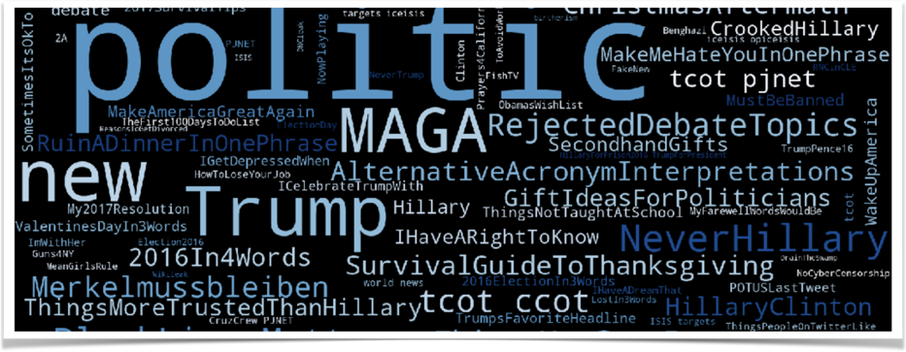

Word Cloud
Most Commonly used words
Word Cloud provides a general context of 200,000 troll tweets.
Notes:
WORD CLOUD!!!
This is an excellent way to visually see the most common hashtags,
but there is no way to quantify the frequency of each hashtag from this!
Let's plot a barplot too

Slide 10
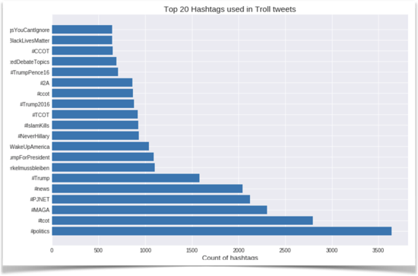

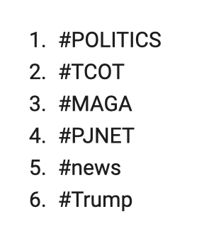
Top 20 Hashtag used in Troll Tweets
Most Commonly used hashtags
Trolls seems highly supported to the Trump’s Presidential Campaign
TCOT:Top conservatives on Twitter
CCOT: Christian conservatives on twitter
Notes:
Here are the most common Hastags in use,
Trolls seems highly supported to the Trump’s Presidential Campaign
by the way just FYI
TCOT means :Top conservatives on Twitter
CCOT: Christian conservatives on twitter

Slide 11
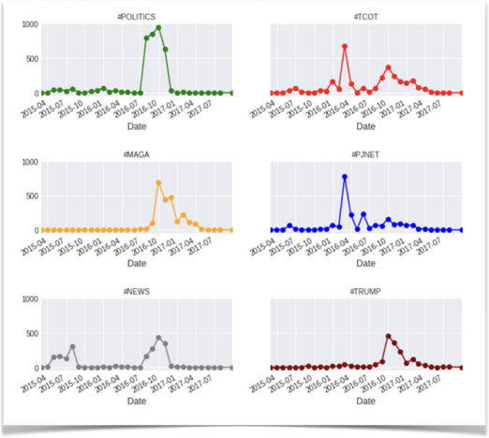
Prior usage of the most common hashtags
Were these hashtags used most before the president's campaign?
Apparently, most of these hashtags picked up in the year 2016 near March or later in July, close to the elections.
Notes:
We also looked at the prior usage of the most common hashtags.
Apparently, most of these hashtags picked up in the year 2016 near March or later in July, close to the elections.

Slide 12

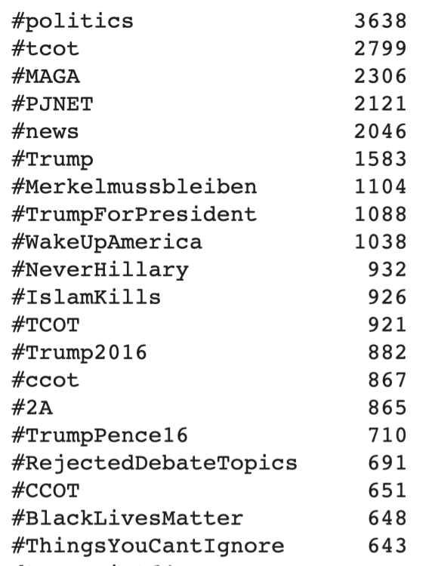
Clustering by HashTags
Most used Hashtags
More than 28,000 unique hashtags
Qualified hashtags
tweeted > 50 times
435 hashtags tweeted
Notes:
Hashtags are important to get some contextual sense of the message of the tweets,
We clustered the hashtags
There were more than 28000 hostages, we picked the group of hashtag tweeted more than 50 times
The number of qualified hashtags reduced significantly to 435.
T

Slide 13
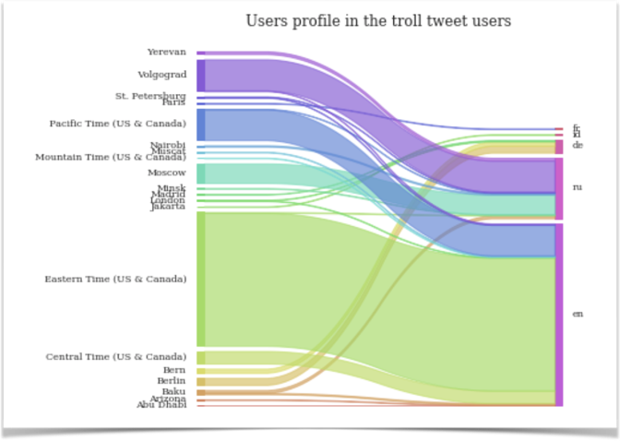
Users Locations and Languages
Sankey Plot - Count of users from each time-zone and language combination
Apparently, English speaking users come from US & Canada .
Russian speaking users come from Moscow, Volgograd, Yerevan and Minsk.
Notes:
We created a SANKEY PLOT to get a sense of which time zone are the users from and what language they speak
Apparently, English speaking users come from US & Canada .
Russian speaking users come from Moscow, Volgograd, Yerevan and Minsk.

Slide 14
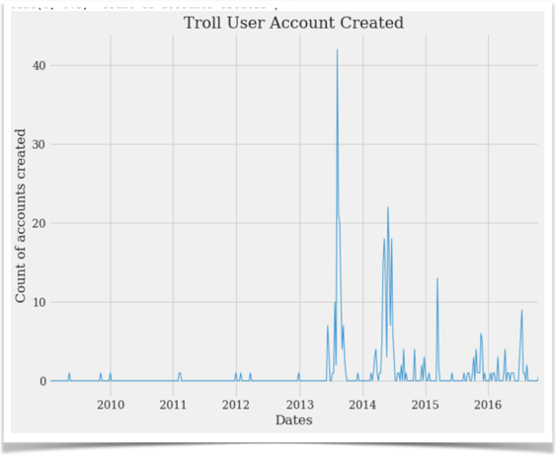
Twitter Accounts creation dates
The created_at column in the users dataframe provides this information
Most accounts were created in the second half of 2013 or first half of 2014
Notes:
We found out that the Most troll accounts were created in the second half of 2013 or first half of 2014

Slide 15
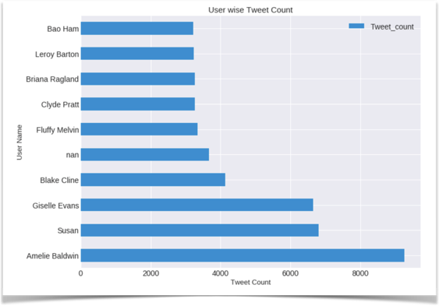

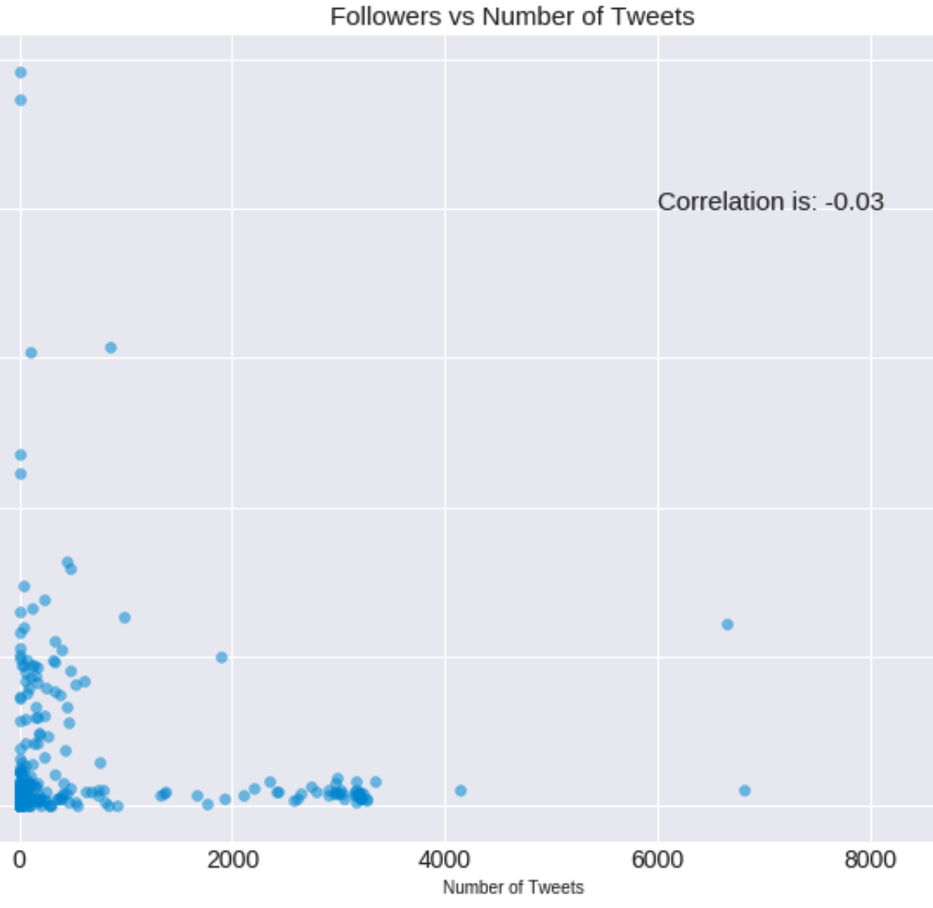
Correlation between higher number of followers and large number of tweets
Many users have very low tweets count
No such correlation exists.
Notes:
NEXT WILL BE SCOTT
We didn’t find correlation between higher number of followers and large number of tweets
Most users have very low tweet counts but their followers range from very few to numerous!
And…Scott will talk about on our Machine Learning Models and Prediction, Scott!!

Slide 16


Keras Model
Deep Learning Learning Library
•Ran in Google Colab
•Combined Troll tweets data with generic political tweets from Election day
•Original combined size: 601,090 tweets
•Sampled due to RAM Restrictions on Colab
•Sample Size 75,136
•Train/Test Split – 50%
•7304 features

Slide 17
Keras Sequential Configuration
1 Inner Layer
Activation – Rectified Linear Unit
Input Dimensions – 7304
Final Layer
Activation – Sigmoid
Input Dimensions – 1
Fit configuration
Batch Size – 10000
Epochs – 16
Val_loss callback patience - 10

Slide 18
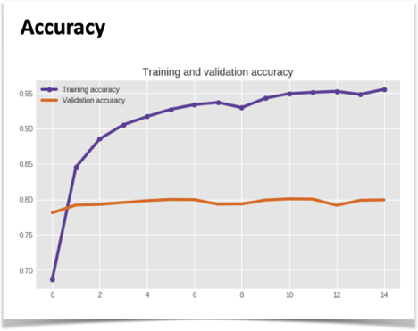

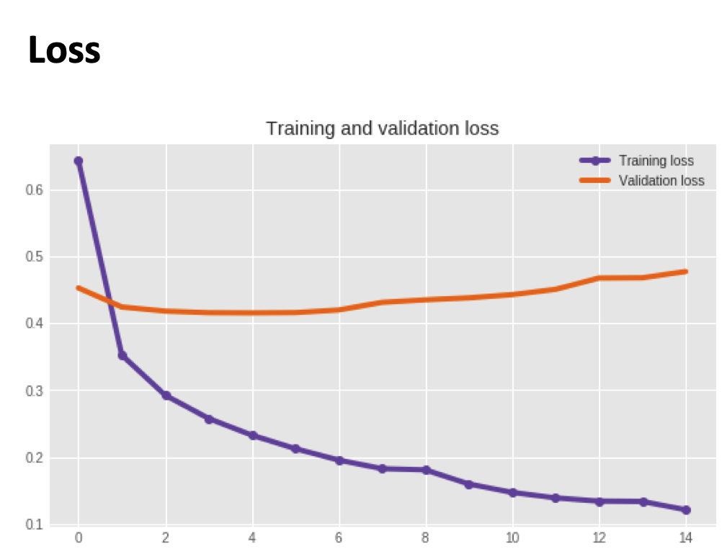
Model Performance by Epoch
Keras Deep Learning Learning Library
Accuracy & Loss

Slide 19

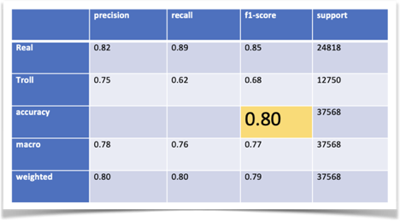
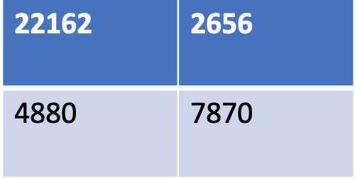
Model Accuracy
Keras Deep Learning Learning Library
•Having the additional tweets likely reduces the potential for accuracy.
•There is unfortunately a time mismatch between the data sets. All of the Real twitter posts were entirely from election day.
•More activation models and more layers will be attempted.

Slide 20
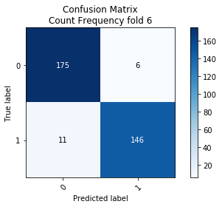


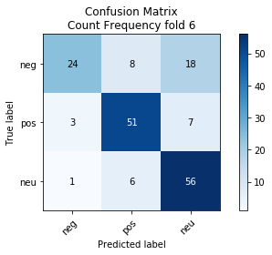
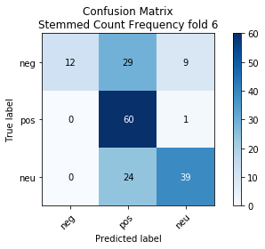
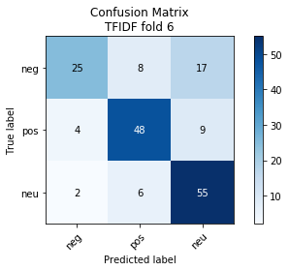
Multinominal Naive Bayes
Real/Fake Prediction Average Accuracy:
Count frequency - 94.9%
TF-IDF - 92.7%
Stemmed count freq. - 94.6%
Sentiment Prediction Average Accuracy:
Count frequency - 73.1%
TF-IDF - 73.9%
Stemmed count freq. - 68.6%

Slide 21
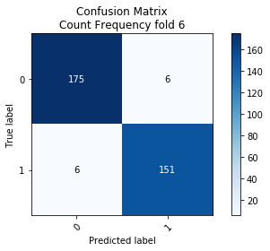


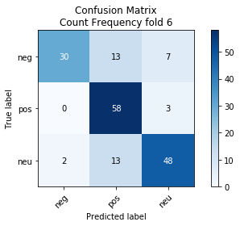

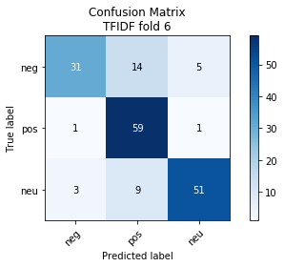
Linear SupportVector Machine
Real/Fake Prediction Average Accuracy:
Count frequency - 96.2%
TF-IDF - 96.4%
Stemmed count freq. - 96.3%
Sentiment Prediction Average Accuracy:
Count frequency - 78.4%
TF-IDF - 80.0%
Stemmed count freq. - 77.2%

Slide 22
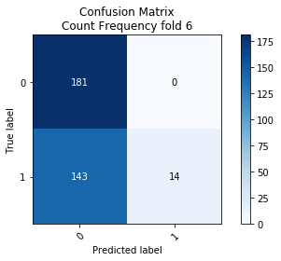
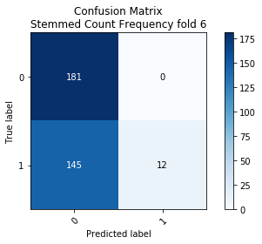
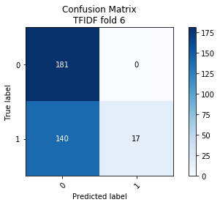
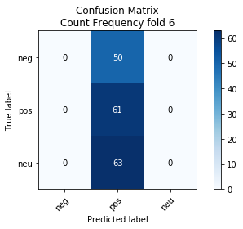
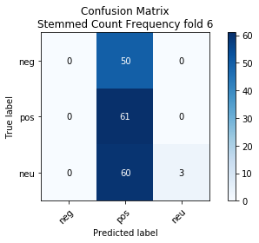
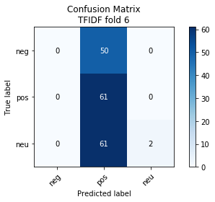
Random Forest
Real/Fake Prediction Average Accuracy:
Count frequency - 70.4%
TF-IDF - 70.5%
Stemmed count freq. - 67.1%
Sentiment Prediction Average Accuracy:
Count frequency - 42.4%
TF-IDF - 42.8%
Stemmed count freq. - 42.6%

Slide 23



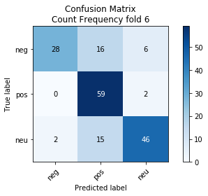


Logistic Regression
Real/Fake Prediction Average Accuracy:
Count frequency - 96.2%
TF-IDF - 95.8%
Stemmed count freq. - 96.3%
Sentiment Prediction Average Accuracy:
Count frequency - 76.0%
TF-IDF - 78.1%
Stemmed count freq. - 70.7%

Slide 24
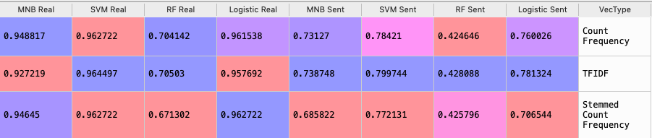
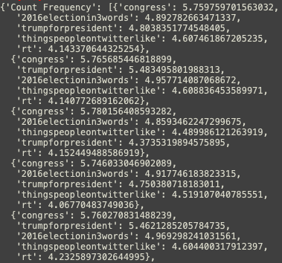
Results
MNB Real Top 5 Feature Importance

Slide 25
Conclusion
Social media and society in general are negatively impacted by trolls. It’s helpful to know who is real and who isn’t.
The trolls attempted to influence and disrupt a broad range of local and global political debates
Most but not all of the content favors the extremist right wing
Some of our models were surprisingly good at predicting bots. Three models consistently predicted with mid-90% accuracy in cross-validation tests (10 folds), independent of vectorization methods
They were also good at predicting sentiment (around 75%, kappa = 0.73).
Keras model predicted with 80% accuracy . We are still looking at the best optimization for the Keras model

Slide 26
References
NBC News
https://www.nbcnews.com/tech/social-media/now-available-more-200-000-deleted-russian-troll-tweets-n844731
Kaggle - Russian Troll Tweets
https://www.kaggle.com/vikasg/russian-troll-tweets
Identifying Tweets Written by Russian Troll Accounts
https://cs230.stanford.edu/projects_spring_2018/reports/8289223.pdf
Still Out There: Modeling and Identifying Russian Troll Accounts on Twitter
https://arxiv.org/pdf/1901.11162.pdf

